Slide 1
Project Synopsis Presentation E-Learning Portal
KIET Group Of Institutions ,(Delhi NCR),Ghaziabad
Department of Computer Application
Made By: Roll No:
Sudarshan Pandey 2100290140137
Ajit Kumar 2100290140010
Arpit Gupta 2100290140037

Slide 2
Content
Introduction
Hardware And Software Required
Module Description
Report/Output
Conclusion
How To Serve The Society

Slide 3
Introduction
The aim of this project is to provide an online learning system with a smooth and well- organized Graphical User Interface easy to understand for the user form first glance. It improves user-accessibility and time flexibility to engage learners in the learning process. The project has been planned to be having the view of distributed architecture, with centralized storage of the database. The application for the storage of the data has been planned.

Slide 4
Hardware and Software Required
HARDWARE REQUIREMENTS-:
1-Hardware
: Processor i3 or above
2-Clock speed
: 3.0 GHz
3-RAM size
: 4 GB or above
4-Hard Disk capacity
: 500 GB or above
5- Peripheral Devices
SOFTWARE REQUIREMENTS-:
1-Operating System
: Windows
2-Browser
: Google chrome or any other
3-Application software
: Visual Studio Code
4-Server
: Apache
5-Documentation
: MS-Office

Slide 5
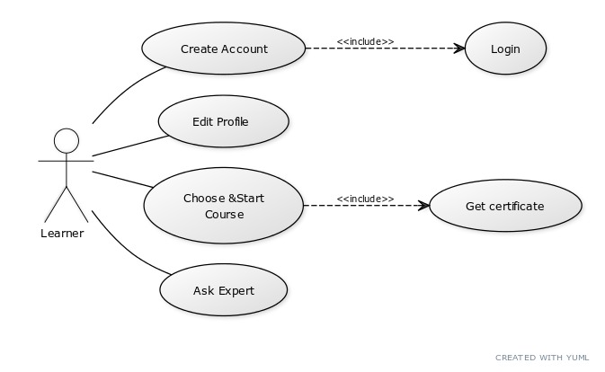
Module Description
(a-) Learner Module

Slide 6
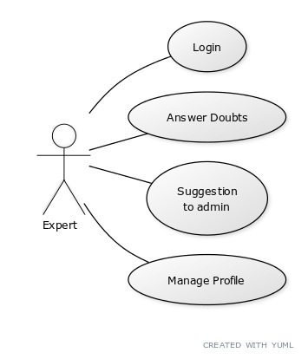
(b-) Expert Module

Slide 7
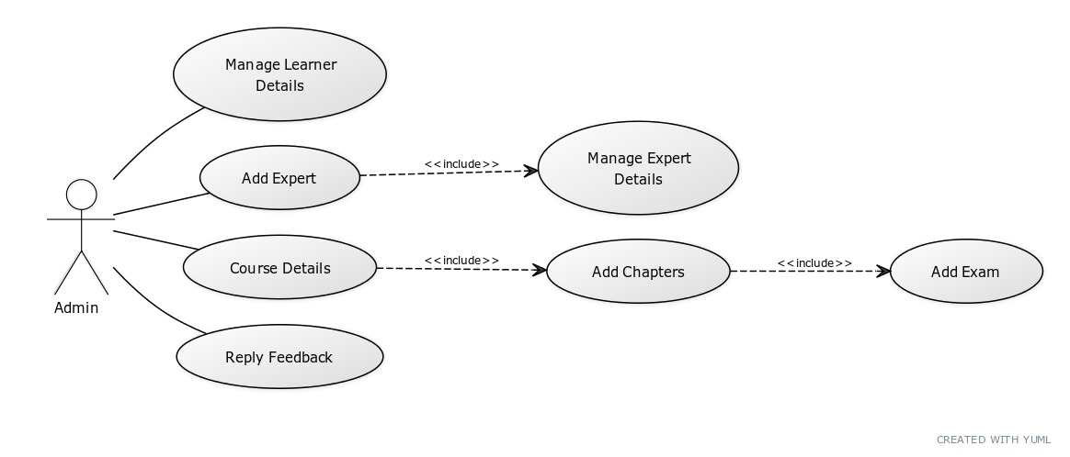
(c-) Admin Module

Slide 8
Report/Output
The output of this project is that , if any learner registered on the e-learning portal and enrolls in a particular course ,clears all the tests and final exam then the output will be that the learner will get a certificate and gain knowledge for that course.
If any company wants some candidates on a particular skill the admin can refer these candidates to get the job.

Slide 9
Conclusion
It will be a great pleasure for us to work on this exciting and challenging project. This project proved good for us as it provided practical knowledge of not only programming in web based application and on SQL Server, but also about all handling procedure related with “E-learning” portal.

Slide 10
How to serve the society
E-learning can improve the performance of individuals, businesses, and society by promoting vital, future-ready skills, such as communication, collaboration, technology, and education. Making online learning accessible for everyone from preschool students to post-graduate learners is in all of our best interests.

Slide 11
Thank You

